Slide 1
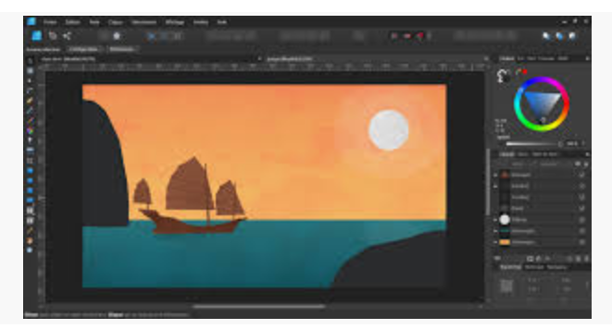
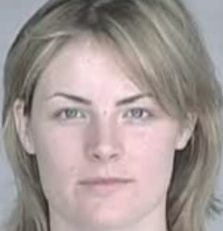
Graphics → Yes, Size does Matter!
Computer Science 1033 – Week 3
https://www.linkedin.com/learning/affinity-photo-essential-training/working-with-selections?u=2152804
Afternoon, n.:
That part of the day we spend worrying about how we wasted the
morning.→ Unix Fortune

Slide 2
Poster Assignment Hints
Follow the instructions carefully, for example:
you get 2 marks if you named your files as stated in the instructions!
If you get a mark for every requirement we ask for.
DON’T Collapse your layers
Name your layers with good names
Check for spelling
Text:
Contrast
Edges
Images
Crisp
Appropriate
Colours

Slide 3
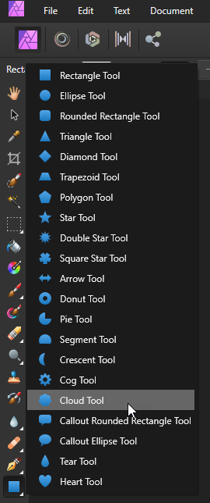
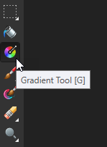
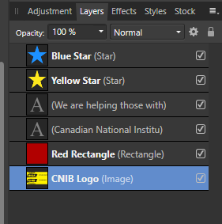
Hints on Assignment
Use the shape tool to create:
A shape, you can use the custom shape tool
Give the shape a good name, don’t collapse the layers

Slide 4
Poster Assignment Tips
Check that you have all the required criteria such as a shape from the shape tool.
Remember to follow the CRAP rules!
Other tips
Colour Choices → https://color.adobe.com/create and http://design-seeds.com/
Notes:
http://www.csd.uwo.ca/~lreid/cs1033/ExamplesForColourMarking.pdf

Slide 5
Remarks!
Remember that if you ask your instructors for a remark…they ALWAYS remark the whole assignment and you get the mark that the instructor gave you NOT the highest mark!
THINK CAREFULLY ABOUT REMARKS!

Slide 6
Big Ideas for This Weeks
Big Idea 1: Mo bits per pixel … Mo Colors!
Big Idea 2: Bitmapped vs Vector: Thumbnail Vectors Icons on the size of a bus? IT IS DOABLE!
Big Idea 3: Mo bits, Mo problems! (The more bits you have to transmit, the slower your image will load unless you compress)
Big Idea 4: Go Smaller or Go Compressing!

Slide 7
Readings
Textbook readings:
Understanding Computers
Files and Folders
Graphics
Basics of Graphics *
Digitized Images *
File Size (first portion of Image Formats and Compression Techniques)
* These two readings were suggested in previous weeks too. You don't have to read them if you did before!

Slide 8
Overview of Today’s Topics
Sampling an image
Black and White, Gray and True Colour
Indexed Colour
Review and worksheet
Bitmaps vs. Vectors
Image file size
Why we need compression

Slide 9

Quantizing The Image
Now that we know how many pieces our image will be broken into, how many colours will we have available to represent each pixel?
Assume for each pixel we have 1 bit to represent the colour.
1 bit can hold either 0 or 1
0 could be white
1 could be black
Thus 1 bit allows for 2 colours, usually black and white (2¹ →2)

Slide 10

How many colours can 2 bit hold? 2² →4
00 → White
01 → Light Gray
10 → Dark Gray
11 → Black

Slide 11
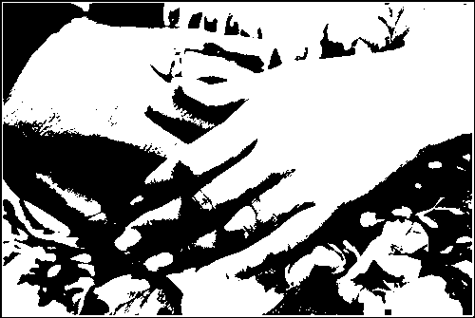
Does 1 bit colour look realistic?
YES → Can you tell what this image represents?

Slide 12
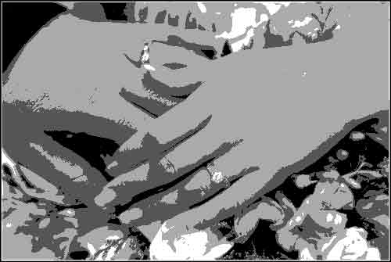
2 Bit Colour
4 shades of gray

Slide 13
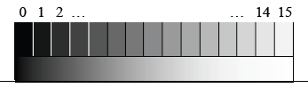
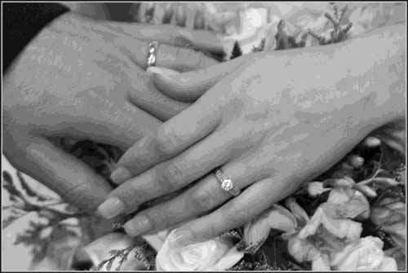
More bits, more shades of gray
4 bit colour → 2⁴ → 16 Shades
0000
0001
0010
0011
1111

Slide 14

How many shades of gray will 8 bits give us?
If this image was 400 pixels by 300 pixels and we used 1 byte (8 bits) for each pixel, the file size would be:
400 X 300 X 1 byte → 120,000 bytes or ~120 kilobytes
http://www.modernimaging.com/bit_depth.htm

Slide 15
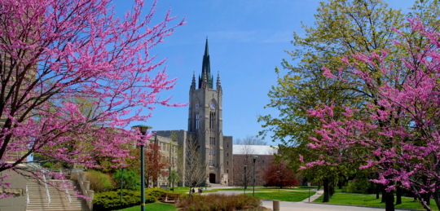
How about some Colour?

Slide 16
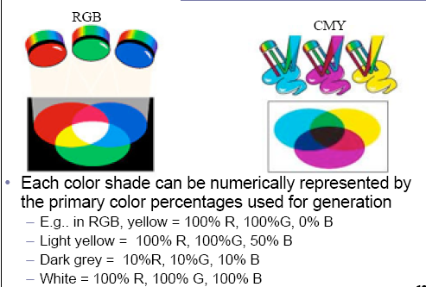
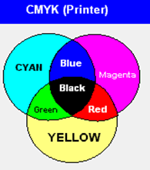
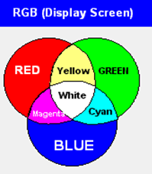
Subtractive Model - CMYK
Additive Model - RGB
Used for printing
Ink applied to paper
Primary Colours → Cyan, Magenta and Yellow
Ink when applied removes (subtracts) the white
Use on monitors
“Adding” light to a black background (the monitor)
Primary Colours → Red, Green and Blue

Slide 17
How do we represent the colours on a Monitor?
True Colour
Can represent 2²⁴ colours → about 16 million different colours
2²⁴ = 2⁸ X 2⁸ X 2⁸ = 256 shades of red, X 256 shades of green X 256 shades of blue
Need 3 bytes (remember: 1 byte=8 bits) for True Colour (1 byte for red, 1 byte for green, 1 byte for blue)

Slide 18
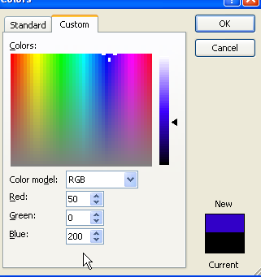
2 Ways to encode True Colours
1. <RGB> <amount of Red, amount of Green, amount of Blue> DECIMAL NUMBER
Where 0 is no amount and 255 is the most allowed
<255, 0, 0> → the most of red, no green, no blue
<0, 255, 0> → the most green, no red, no blue
<100,100,100> → equal middle amounts of red, green and blue
<50, 0, 200> → a little red, a lot of blue
<200, 0, 50> → a lot of red, a little blue

Slide 19
2. Hexadecimal Code
#RRGGBB → RR are the digit place holders for the amount of red, GG amount of Green, BB amount of Blue
Amounts are counted in hexadecimal with these digits: 0,1,2,3,4,5,6,7,8,9,A,B,C,D,E,F
00 still means 0
Hex FF= Decimal 255 (try the calculator to see)
Hex to Dec → 00=0, 01=1, 02=2, 03=3, 04=4, 05=5, 06=6, 07=7, 08=8, 09=9, 0A=10, 0B=11, 0C=12, 0D=13, 0E=14, 0F=15, 10=16, 11=17,….. FD=253, FE=254, FF=255.
#FF0000 → Red
#00FF00 →Green
#000000 → Black
Question: what is the hex for WHITE?

Slide 20
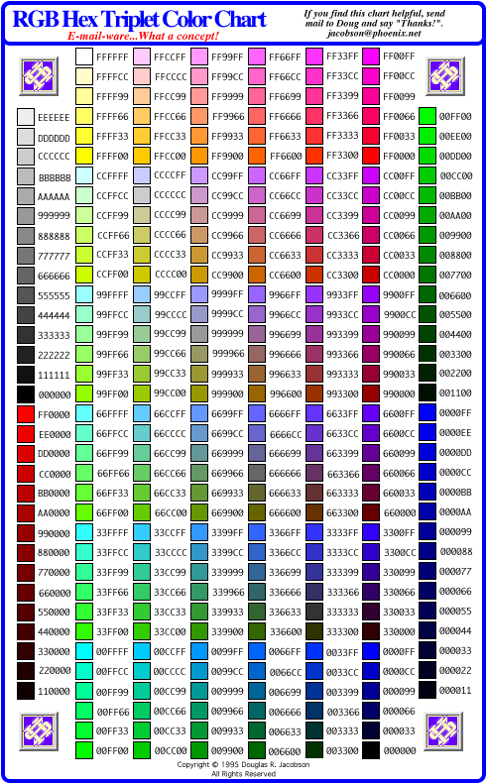
Some hexadecimal colours:
Question: Are these colours the same:
<0,0,0> and #000000?
<0,0,0> and #000000?
<9,8,7> and #090807
<10,15,09> and #__ __ 09
<255,0,255> and #FF00FF
<255,0,255> and #FF00FF
<66,0,99> and #660099 ?
<66,0,99> and #660099 ? NO
0A 0F
http://easycalculation.com/color-coder.php
http://easycalculation.com/rgb-coder.php

Slide 21
Can you represent the same number of colours using Hex as using RGB
YES
https://www.rapidtables.com/convert/number/hex-dec-bin-converter.html
 | Red | Green | Blue | How many colours?
Smallest Value (RGB) | 0 | 0 | 0
Biggest Value (RGB) | 255 | 255 | 255
Total number of shades you can represent | 256 | 256 | 256 | 256X256X256→16 million colours
Smallest Value (Hex) | 00 | 00 | 00
Biggest Value (Hex) | FF | FF | FF
Total number of shades you can represent | 16X16→ 2⁴X2⁴→2⁸ | 16X16→ 2⁴X2⁴→2⁸ | 16X16→ 2⁴X2⁴→2⁸ | 2⁸ X2⁸ X 2⁸ →2²⁴→16 million colours
Smallest Value (Binary) | 00000000 | 00000000 | 00000000
Biggest Value (Binary) | 11111111 | 11111111 | 11111111
Total number of shades you can represent | 2X2X2X2X2X2X2X2→2⁸ | 2X2X2X2X2X2X2X2→2⁸ | 2X2X2X2X2X2X2X2→2⁸ | 2⁸ X2⁸ X 2⁸ →2²⁴→16 million colours

Slide 22
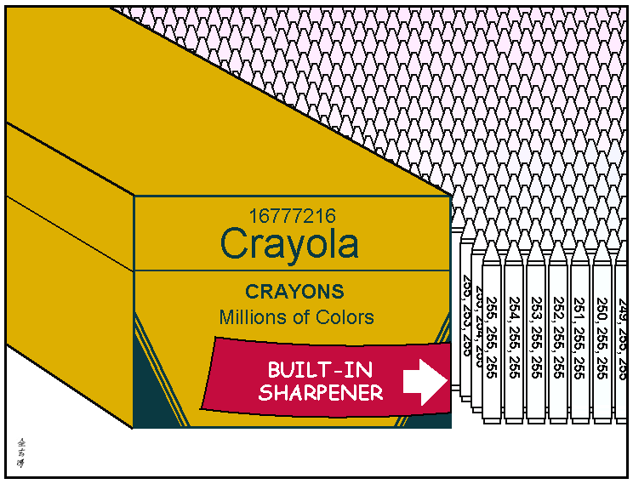
How many colours do we need to encode?
QUESTION: Roughly, what is the maximum number of colours the human eye can detect?
Less than 10 million
Notes:
Less than 10 million

Slide 23
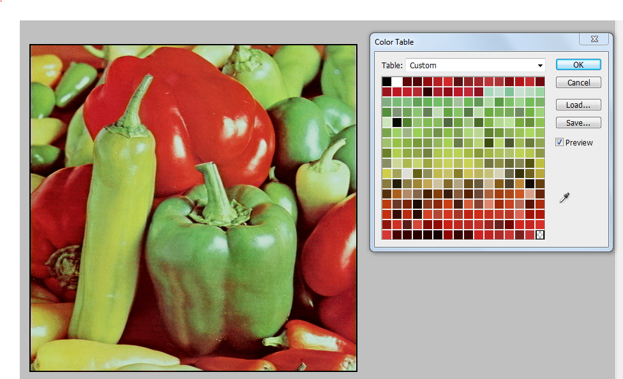
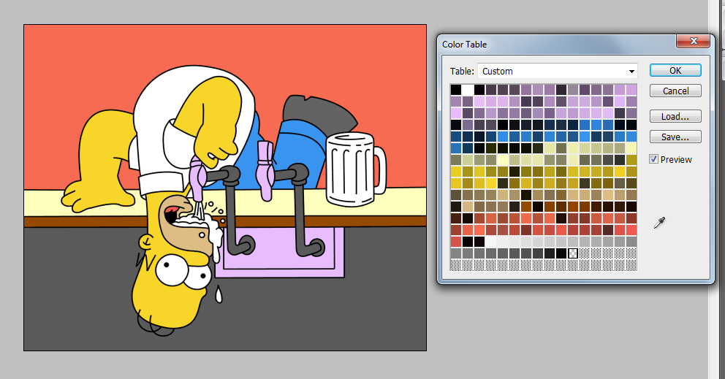
Colour Continued…Indexed Colour (not true colour)
Sometimes we don’t need 16 million colours, then we use indexed colour (an index that maps to a group of colours we plan to use)
QUESTION: What types of images don’t need a full palette of colours?
Our index might be 8-bits→ 2⁸ different colours (just like with gray shades) thus we can show 256 different colours.
Called the Image Bit Depth, e.g. 8 bit depth
We only index the colours we need (if we will never use purple in our image, don’t need to include it in the index of colours)
Why do the bottom boxes appear to have no colours in them?
Notes:
Answer: Animated Images

Slide 24
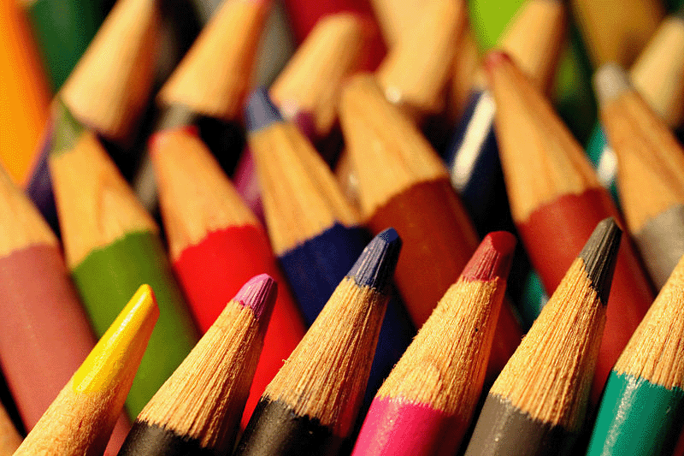
Indexed Colour
Indexed Colour can look pretty good even though we will only ever have at most, 8-bit colour (or 256 shades of colour)
http://www.csd.uwo.ca/~lreid/cs033/BitDepth/

Slide 25
Review:
Match the encoded colour to the correct colour name:
Encoded Colour
a) #FFFFFF b) #00FF00 c) #FAFAFA d) <0,0,255> e) <0,0,0> f) <14,14,14> g) <125,125,125>
Colour Name
1. White 2. Black 3. Dark Gray 4. Light Gray 5. Medium Gray 6. Bright Green 7. Bright Blue
Encoded Colour
a) #FFFFFF b) #00FF00 c) #FAFAFA d) (0,0,255) e) (0,0,0) f) (14,14,14) g) (125,125,125)

Slide 26

Bitmapped Images vs. Vector Graphics
Bitmapped Graphic Image
Image consists of pixels in a grid
Icons are an example of a bitmapped image (do you recognize this icon? → ) Icons are usually 32 pixels by 32 pixels
When bitmapped images are enlarged (resampled), the computer adds new pixels and guesses on the colour to colour the new pixels (called interpolation) based on surrounding pixels
This icon is now 245 pixels by 245 pixels
Bitmapped images edges become jagged

Slide 27
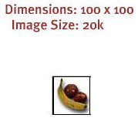
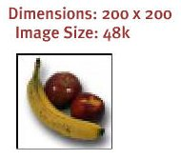
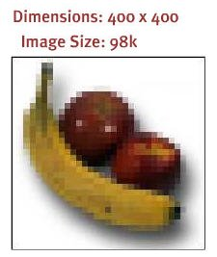
Bitmapped Images
Also called raster graphics image
Bitmapped images are resolution dependent
Bitmapped image on a 640 by 480 screen (lower resolution) appear larger than on a 1280 by 1024 screen (higher resolution)
Bitmapped images that are enlarged:
Have larger file size than original
Become distorted
All images from scanners and digital cameras are bitmapped images

Slide 28
Common Bitmap Formats
Common bitmap file formats are:
BMP (has little compression, makes big files!)
GIF
JPEG, JPG
PNG
PICT (Macintosh)
PCX
TIFF
AFPHOTO (Affinity Photo)
PSD (Adobe Photoshop)
Popular bitmap editing tools/software packages:
Microsoft Paint
Adobe Photoshop
Affinity Photo
Corel Photo-Paint
Corel Paint Shop Pro
The Gimp

Slide 29
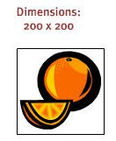
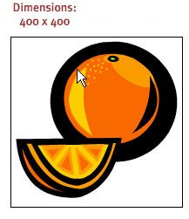
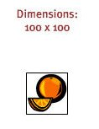
Vector Graphics
Vector image is made up of individual, scalable objects.
Objects are defined by mathematical equations
Objects consist of lines, curves and shapes
No distortion as image is enlarged

Slide 30


Vector Graphics
As image is enlarged, still has crisp clean lines.
Most browsers don’t display vector graphics without a plug in.
Only can be used with drawings, not photographs
Usually vector graphic image has a smaller file size than the same image stored as a bitmap.
Below: enlarging and shrinking an image: left using a vector graphical image, right using a bitmapped image

Slide 31
Vector Images
Example: HTML 5 allows it now: https://www.w3schools.com/graphics/svg_inhtml.asp
Try changing the values
Great for logos because
Can be scaled down for business card
Can be scaled up for a trade show poster
https://youtu.be/PJFc3KlEdLM?t=61 (watch till about minute 4)
Note: the text in PDF files are Vector based (but not the images in a pdf file)

Slide 32
Common Vector File Formats
Common Vector file formats include:
AI (Adobe Illustrator)
CDR (CorelDRAW)
CMX (Corel Exchange)
CGM Computer Graphics Metafile
DXF AutoCAD
WMF Windows Metafile
EPS (Encapsulated PostScript)
PDF
Popular vector drawing programs/software packages are:
Adobe Illustrator
Affinity Designer
CorelDRAW
Xara Xtreme
Serif DrawPlus

Slide 33
Activity 1
Open MS Paint (Start>Programs>Accessories>Paint)
Pick the text tool, set the font to 50pt, type in your name
Pick the text tool again, set the font to 12pt, type in your name
Select the small font and resize it to the size of the big font
Do they look the same?

Slide 34
Activity 2
Draw an oval in MS Paint, then select it and resize it, watch what happens
Draw an oval in Affinity Photo,
Select Layer>Layer Style and give it an outline (Stroke)
Select the oval layer and select Edit>Transform Path>Scale and resize it, watch what happens.
Usually when you see the command “Document>Flatten” in Affinity Photo, it is changing your Vector layers into a one flat Bitmapped layer!

Slide 35
Try it out
http://www.csd.uwo.ca/~lreid/cs1033/vectors/star.html
https://upload.wikimedia.org/wikipedia/commons/e/e6/Phone.svg

Slide 36
Bitmapped Graphics vs. Vector Graphics
Question: Which of these statements do you think is TRUE: A or B?
A: You can convert a vector graphic image into a bitmapped image easily but you cannot easily convert a bitmapped image into a vector graphic image.
B: You can convert a bitmapped image into a vector graphic easily but you cannot easily convert a vector graphic image into a bitmapped image.

Slide 37
How to lose customers before you ever even had them!
Have you ever gone to a website and then left within seconds because the graphics were taking too long to download?
Do you ever return?
http://www.flamingpear.com/examples-sbp/images/blue-green-sea-large.jpg
http://www.csd.uwo.ca/~lreid/cs1033/resolution/UncompressedGraphics.html

Slide 38
How Big Is An Image?
Let’s figure out how many bytes one large picture in true colour (2²⁴ colours) would take up.
Roughly:
Total Numbers of pixels (Sampling) * Colour Big Depth (Quantize)
Length (px) * width (px) * Colour bit depth(bytes)
Question: Assume we have a picture that is:
1600 pixels by 1200 pixels (takes up the whole screen and more depending on your resolution)
Each pixel will need 3 bytes (8 bits for red, 8 bits for green, 8 bits for blue) to represent the colour of each pixel <R,G,B>
How many bytes, kilobyte and megabytes is the image? →
1600 * 1200 * 3 = 5,760,000 bytes
5760000/1024 = 5625 Kilobyte
5625/1024 = 5.5 Megabytes
Save a picture this size in Affinity Photo as .raw to find size
http://www.csd.uwo.ca/~lreid/cs1033/resolution
Look at the size of the file with the extension .raw
UNITS OF MEASURE:
How about kilobytes, megabytes, etc?
1 KB = 1024 B
1 MB = 1024 KB
1 GB = 1024 MB
1 TB = 1024 GB
* Some people use 1000 for these conversions.

Slide 39
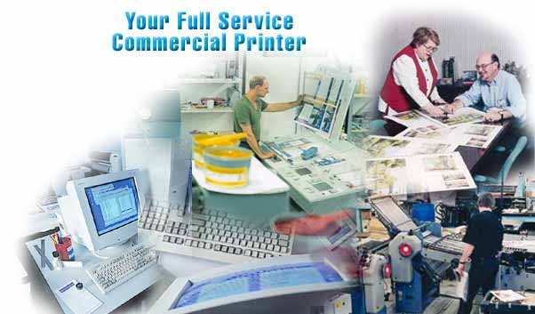
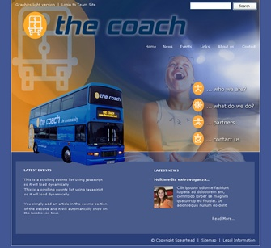
We need to decide what are we going to use the image for?
For Printing in a Flyer or Magazine:
For Displaying in a Web Page:
File size doesn’t matter
Most important issue is the quality of the image!
Image will be printed with at least 300dpi
File size is very important
Bigger files take longer to download
Quality is important too but want to try to get best quality with smallest file size.

Slide 40
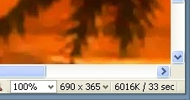
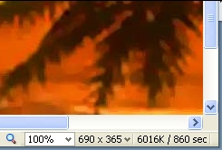
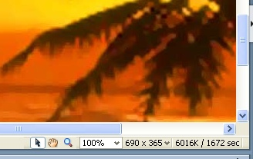
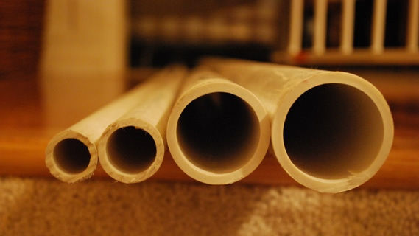
How long will it take that uncompressed sunset image to download if we are using it in a webpage?
If the client is using high speed connect at 1500 kilobits per second?
If the client is on a modem that is 56 kilobits per second
On a really old modem that is 28.8 kilobits per second?
33 Seconds
860 Seconds or 14.33 Minutes
1672 Seconds or 28.66 Minutes
Notes:
Drawings, paintings

Slide 41
We need to make our webpages download as fast as possible
We want them to be the “appropriate size” for our page, in terms of proportion
Want the image to look good (“high quality”)
Want image to download quickly
THUS WE NEED TO MAKE OUR IMAGE FILES SMALLER BUT OUR IMAGE TO STILL LOOK GOOD!

Slide 42
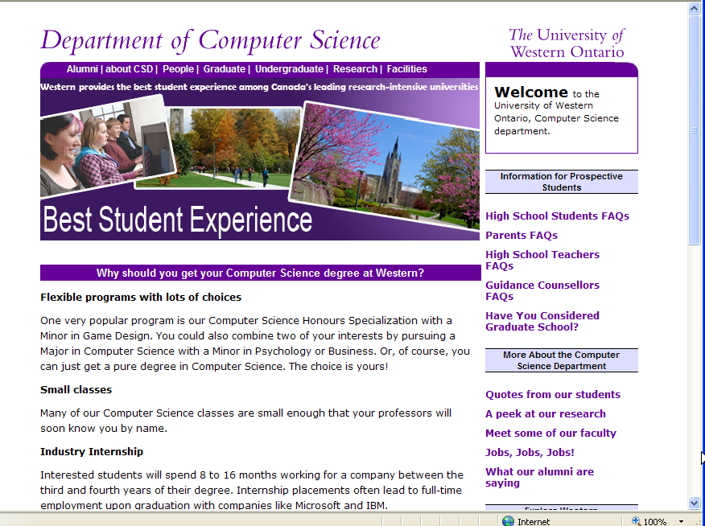

Below,
-Image size isn’t appropriate
-Doesn’t look good
-BUT it does download faster than the top page because the image is smaller

Slide 43
How do we download faster?
Make our image file size smaller!
Question: What can we do to make our images smaller?
OPTION 1: Make the image be physically smaller → LESS PIXELS (BUT that will change the size it is displayed at on the screen).
For example, a 100 pixel by 100 image pixel (30KB) is smaller than a 200 pixel by 200 pixel image (118KB)

Slide 44
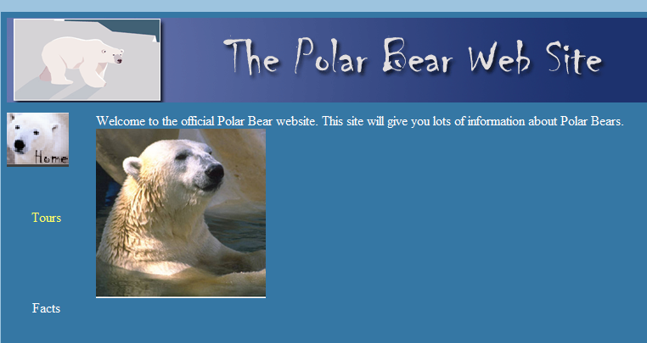
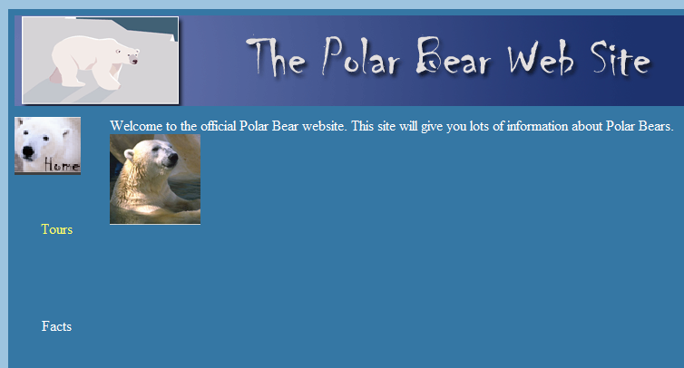
200 by 200 pixels
This is how you wanted the image to look within your page!
100 by 100 pixels
Did you really want the polar bear to be this small?

Slide 45
How do we download faster and keep the image the size we want it?
OPTION 2: COMPRESS THE IMAGE FILE: use tricks to make file smaller without losing the quality of the image or the size (in pixels of the image)
Still 200 pixels by 200 pixels but the file size is smaller than the original.
An uncompressed image that is:
200 by 200 pixels
True Colour (16 million colours → <R,G,B>)
Will be 200 * 200 * 3 bytes = 120,000 bytes
Will be 120,000 / 1024 = 117.2 Kilobytes

Slide 46
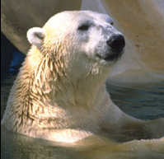
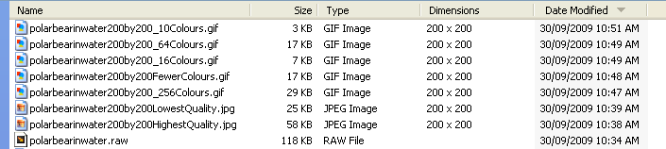
Compression To The Rescue!
The same image that is:
200 by 200 pixels
Original size was 118 kbytes (200*200*3/1024)
Looks almost like true colour when:
SAVED AS A COMPRESSED JPG WILL BE:
Highest Quality → 58 KB
Lowest Quality → 25 KB
SAVED AS A COMPRESSED GIF WILL BE:
256 Colours →29KB
64 Colours →17KB
16 Colours →7KB
10 Colours →3KB

Slide 47
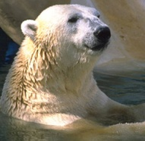
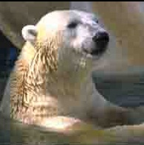
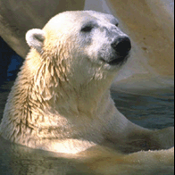
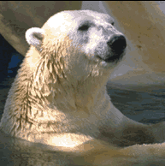
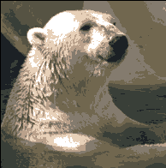
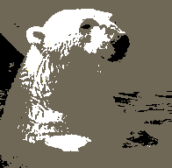
Raw Image
118KB
Highest Quality JPG
58 KB
Lowest Quality JPG
25KB
256 Colours GIF
29 KB
64 Colours GIF
17 KB
16 Colours GIF
7 KB
10 Colours GIF
3 KB
Note: this one is 40 times than the uncompressed file smaller BUT the quality of the image is very poor!

Slide 48
Compression
Key Concept: Compress as much as you can WITHOUT sacrificing quality (losing information)!
Is there a way we can stuff the bits and bytes down into less bits and bytes?

Slide 49
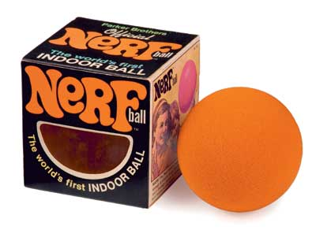
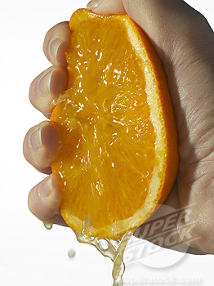
Two Types of Compression
Lossless:
Compress the original bits and bytes into less bits and bytes without losing any of the original information about the picture
When we reopen the file, all the original information about the picture is still there!
NO INFORMATION IS LOST
Lossy:
When compression occurs, some of the original information is lost
Selected portions of the image are discarded but the selected portions are the ones that will be the ones that least missed or noticed
CANNOT GET THIS INFO BACK ONCE IT IS DISCARDED
Nerf Ball vs. Orange ☺

Slide 50
Several different algorithms for (ways to perform) compression
Each different type of image file format represents the use of a different compression algorithm
Common compressed image file formats that are acceptable on the World Wide Web:
gif
jpg, jpeg
png
Uncompressed file formats:
bmp (for Windows)
raw (common on digital cameras)

